Slide 1
mHSPC
Dr. Nidal KHEDER
HHead of oncology department
Ibn-Alnafis Hospital – Damascus
05.12.20258.10.2020

Slide 2
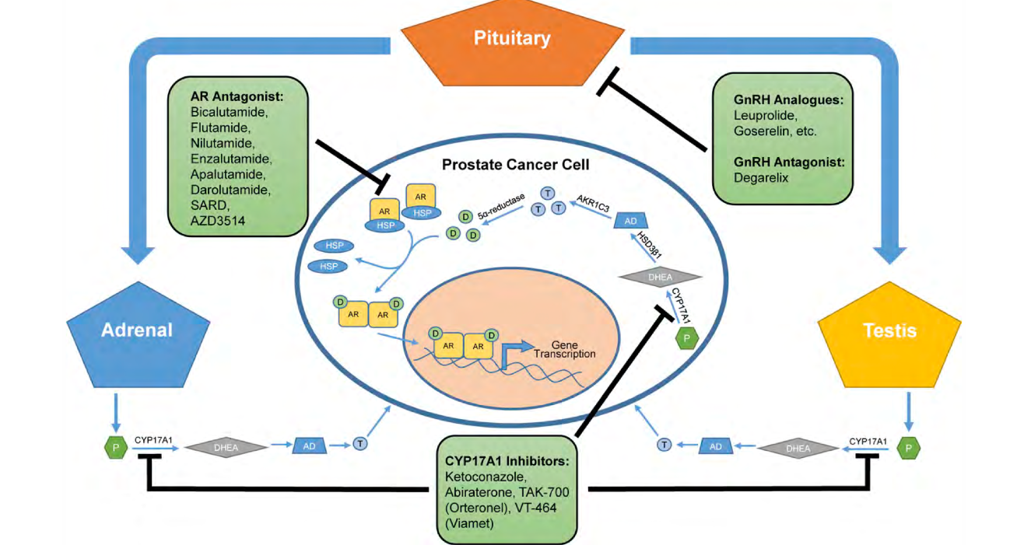

Slide 3
Prostate Cancer Diagnosis May Occur at Various
Stages and Progress Through Different Pathways
De novo metastatic prostate cancer
mHSPC
High volume
Low volume
Oligometastatic
Identification of metastases
Rising PSA
Localized/locally advanced
prostate cancer
Definitive therapy
Biochemical recurrence*
Both criteria met
mCRPC
Rising PSA despite castrate levels of testosterone
nmCRPC
*Slow PSA doubling time (eg, >10 mo) suggests indolent disease.
Hormone-sensitive prostate cancer defined as disease that has either not been treated with, or is still responsive to, ADT
Anantharaman. Expert Rev Anticancer Ther. 2017;17:625. NCCN. Prostate cancer. v.1.2023.
Notes:
ADT, androgen-deprivation therapy; mCRPC, metastatic castration-resistant prostate cancer; mHSPC, metastatic hormone-sensitive prostate cancer; nmCRPC, nonmetastatic castration-resistant prostate cancer; PSA, prostate-specific antigen.

Slide 4
Select Randomized Clinical Trials in High Volume mCSPC
Trial¹ | Comparator Arm | Control Arm | n | HR for PFS (or Other Endpoint) | HR for OS
RT
STAMPEDE Arm H² | RT to prostate | ADT (+ Doc possible) | 1120 | NA | 1.07
HORRAD³ | RT to prostate | ADT | 272 | NA | 1.06
Docetaxel
CHAARTED⁴ | ADT + Doc | ADT | 513 | 0.58 (time to CRPC) | 0.63
STAMPEDE Arm C⁵ | ADT + Doc | ADT | 468 | 0.68 | 0.81
AR Pathway Inhibitor
LATITUDE⁶ | ADT + ABI + Pred | ADT | 955 | 0.47 (rPFS) | 0.62
STAMPEDE Arm G⁷ | ADT + ABI + Pred | ADT | 473 | 0.31 (FFS) | 0.54
ENZAMET⁸ | ADT + ENZA (± Doc) | ADT + NSAA (± Doc) | 588 | 0.45 | 0.80
ARCHES⁹ | ADT + ENZA* | ADT* | 727 | 0.63 (rPFS) | 0.66
TITAN¹⁰ | ADT + APA* | ADT* | 660 | 0.53 (rPFS, ITT) | 0.68
Triplet Therapy
PEACE-1¹¹ | ADT + ABI + Pred + Doc† | ADT + Doc† | 456 | 0.47 (rPFS) | 0.72
ARASENS¹² | ADT + Doc + Darolutamide | ADT + Doc + Pbo | 1005 (high vol) 912 (high risk) | 0.41 (time to CRPC) 0.38 (time to CRPC) | 0.69 0.62
1. VanderWeele. JCO. 2019;37:2961. 2. Parker. Lancet. 2018;392:2353. 3. Boevé. Eur Urol. 2019;75:410. 4. Kyriakopoulos. JCO. 2018;36:1080.
5. Clarke. Ann Oncol. 2019;30:1992. 6. Fizazi. Lancet Oncol. 2019;20:686. 7. Hoyle. Eur Urol. 2019;76:719. 8. Davis. NEJM. 2019;381:121.
9. Armstrong. JCO. 2022;40:1616. 10. Chi. NEJM. 2019;381:13. 11. Fizazi. Lancet. 2022;399:1695. 12. Hussain. JCO. 2023;[Epub].
*Prior docetaxel allowed.
†With or without RT.
Notes:
ABI, abiraterone; ADT, androgen-deprivation therapy; APA, apalutamide; CRPC, castration-resistant prostate cancer; Doc, docetaxel; ENZA, enzalutamide; FFS, failure-free survival; mCSPC, metastatic castration-sensitive prostate cancer; NA, not available; NSAA, nonsteroidal antiandrogen; OS, overall survival; PFS, progression-free survival; Pred, prednisone; rPFS, radiographic PFS; RCT, randomized controlled trial; RT, radiotherapy.

Slide 5
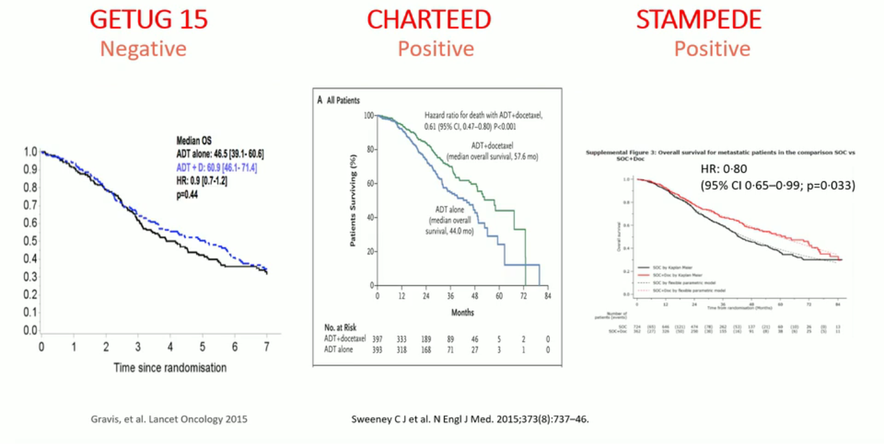

Slide 6
Final OS Results for Phase III Trials of AR Inhibition + ADT in Patients With mCSPC
LATITUDE: ADT + Abiraterone
vs ADT (N = 1199)¹
Median f/u: 51.8 mo
ARCHES: ADT + Enzalutamide
vs ADT (N = 1150)²
Median f/u: 44.6 mo
TITAN: ADT + Apalutamide
vs ADT (N = 1052)³
Median f/u: 44.0 mo
100
100
100
80
80
80
60
60
60
OS (%)
40
40
40
20
 | AAP + ADT | Pbo + ADT
Median OS, mo | 53.3 | 36.5
HR (95% CI) | 0.66 (0.56-0.78; P <.0001)
20
 | ENZA + ADT | Pbo + ADT
Median OS, mo | NR | NR
HR (95% CI) | 0.66 (0.53-0.81; P <.0001)
20
 | APA + ADT | Pbo + ADT
Median OS, mo | NR | 52.2
HR (95% CI) | 0.65 (0.53-0.79; P <.0001)
0
0
0
0
6
12
18
24
30
36
42
48
54
60
66
0
6
12
18
24
30
36
42
48
54
60
0
6
12
18
24
30
36
42
48
54
60
Mo
Mo
Mo
Cross-trial comparisons have significant limitations. This information is presented to generate discussion, not to make direct comparisons among study results.
1. Fizazi. Lancet. 2019;20:686. 2. Armstrong. JCO. 2022;40:1616. 3. Chi. JCO. 2021;39:2294.
Notes:
AAP, abiraterone acetate + prednisone; ADT, androgen-deprivation therapy; APA, apalutamide; ENZA, enzalutamide; f/u, follow-up; mCSPC, metastatic castration-sensitive prostate cancer; NR, not reached; OS, overall survival; Pbo, placebo.

Slide 7
PEACE-1 and ARASENS: OS
PEACE-1¹
Median f/u: 4.4 yr
ARASENS²
Median f/u: 42.4-43.7 mo
100
100
80
80
60
60
OS (%)
OS (%)
40
40
 | AAP + Doc + ADT* (n = 355) | Doc + ADT* (n = 355)
Median OS, yr | NR | 4.4
HR (95.1% CI) | 0.75 (0.59-0.95; P = .017)
 | Darolutamide + Doc + ADT (n = 651) | Pbo + Doc + ADT (n = 654)
Median OS, mo | NR | 48.9
HR (95% CI) | 0.68 (0.57-0.80; P <.001)
20
20
0
0
0
1
2
3
4
5
0
3
6
9
12
15
18
21
24
27
30
33
36
39
42
45
48
51
54
57
60
Yr Since Randomization
Mo Since Randomization
Patients at risk, n
AAP + Doc + ADT* | 355 | 328 | 287 | 183 | 98 | 25
Doc + ADT* | 355 | 329 | 281 | 172 | 78 | 18
Patients at risk, n
Darolutamide + Doc + ADT | 651 | 645 | 637 | 627 | 608 | 593 | 570 | 548 | 525 | 509 | 486 | 468 | 452 | 436 | 402 | 267 | 139 | 56 | 9 | 0 | 0
Pbo + Doc + ADT | 654 | 646 | 630 | 607 | 580 | 565 | 535 | 510 | 488 | 470 | 486 | 424 | 402 | 383 | 340 | 218 | 107 | 37 | 6 | 1 | 0
1. Fizazi. Lancet. 2022;399:1695. 2. Smith. NEJM. 2022;386:1132.
*With or without RT.
Notes:
AAP, abiraterone acetate + prednisone; ADT, androgen-deprivation therapy; doc, docetaxel; f/u, follow-up; NR, not reached; OS, overall survival; pbo, placebo.

Slide 8
Systemic Therapy for Metastatic Castration-Sensitive Prostate Cancer 2023
If chemotherapy is
not preferred*
Abiraterone or apalutamide or enzalutamide
Patients with mCSPC
ADT plus:
+ local therapy to primary (SWOG-S1802)¹
+ RT to oligomets (STAMPEDE,² PLATON³)
If chemotherapy is
preferred*
Docetaxel + abiraterone or docetaxel + darolutamide⁴
Denosumab 60 mg SC every 6 mo
Zoledronic acid 5 mg IV/yr
Alendronate 70 mg PO/wk
For men with a 10-yr risk of hip fracture of ≥3% based on the FRAX algorithm
*Considerations
for
chemotherapy
preference
Chemotherapy fitness, symptom burden, cost/insurance coverage, patient preference
Low- vs high-volume disease, prior local therapy vs no⁵
Histologic/molecular features
  Poorly differentiated, low PSA producing
  Genetic features⁶
  Gene expression profiling⁷
1. NCT03678025. 2. Clarke. Ann Oncol. 2019;30:1992. 3. NCT03784755. 4. Smith. ASCO 2022. Abstr 13.
5. Gravis. Eur Urol. 2018;73:847. 6. Velez. Prostate Cancer Prostatic Dis. 2021;[Epub]. 7. Hamid. Ann Oncol. 2021;32:1157.
Notes:
ADT, androgen-deprivation therapy; FRAX, fracture risk assessment tool; mCSPC, metastatic castration-sensitive prostate cancer; PSA, prostate-specific antigen; RT, radiotherapy.

Slide 9
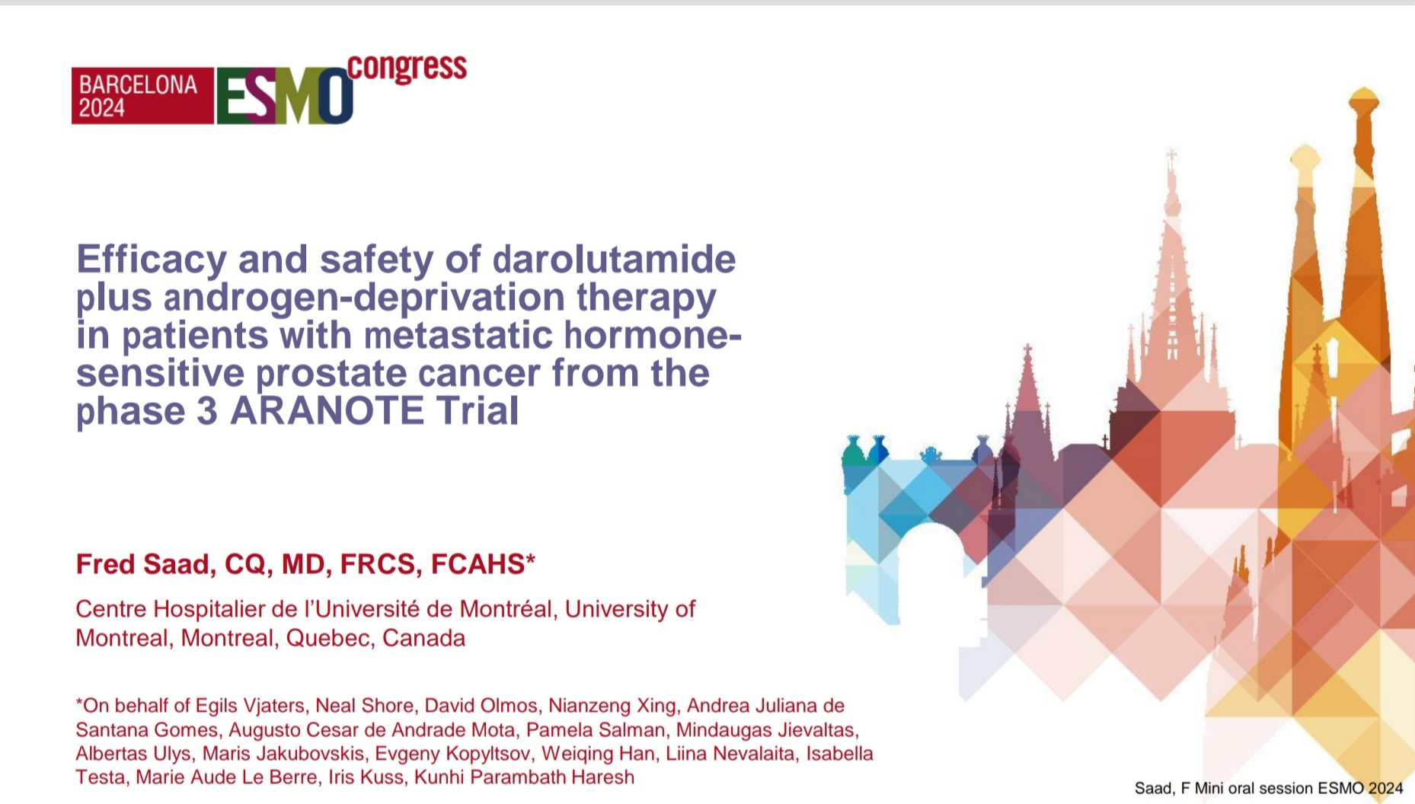

Slide 10
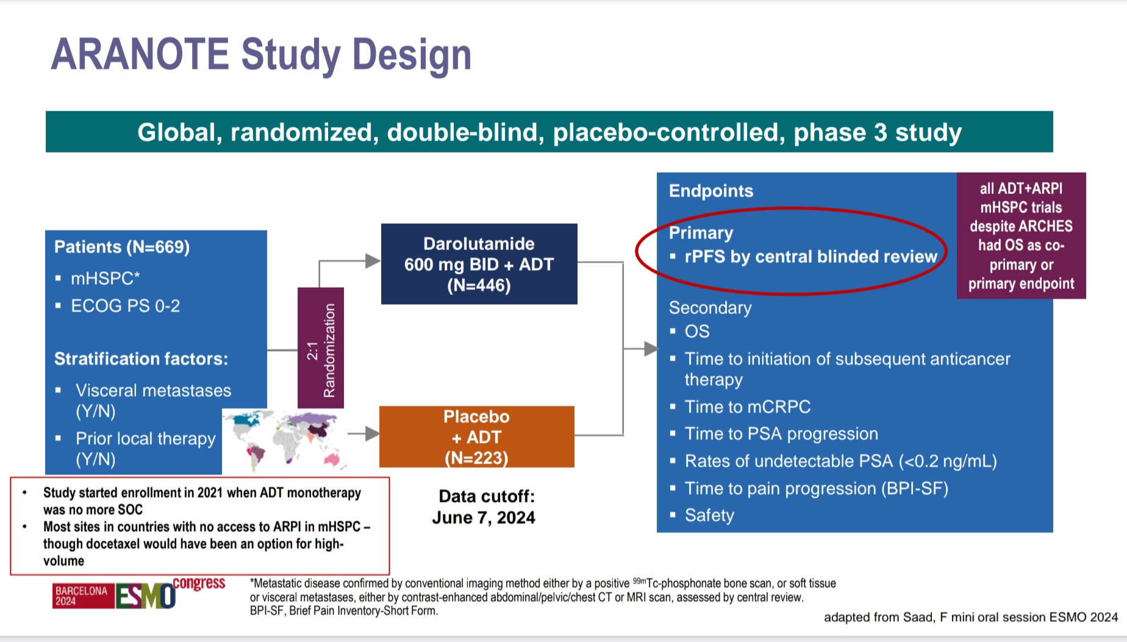

Slide 11
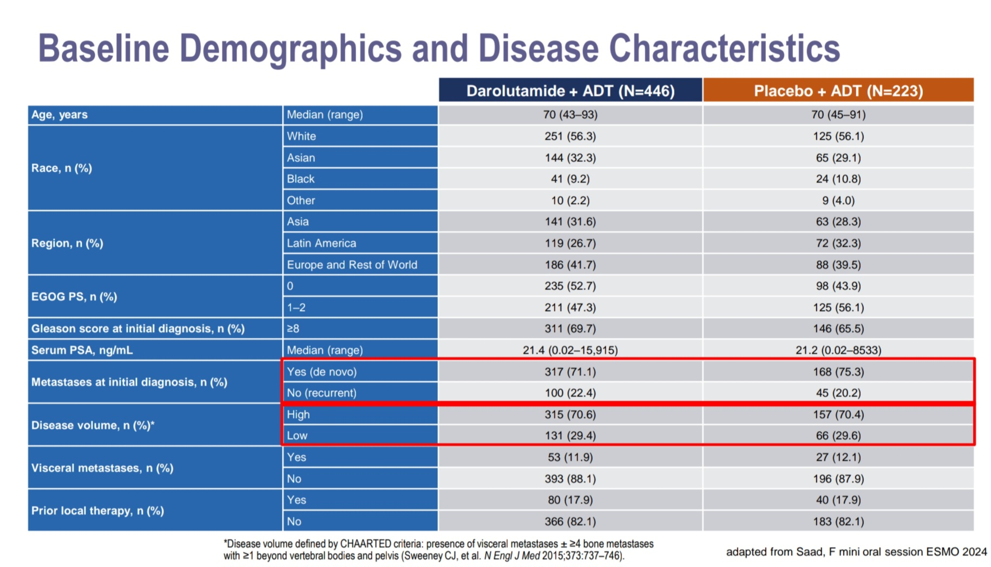

Slide 12
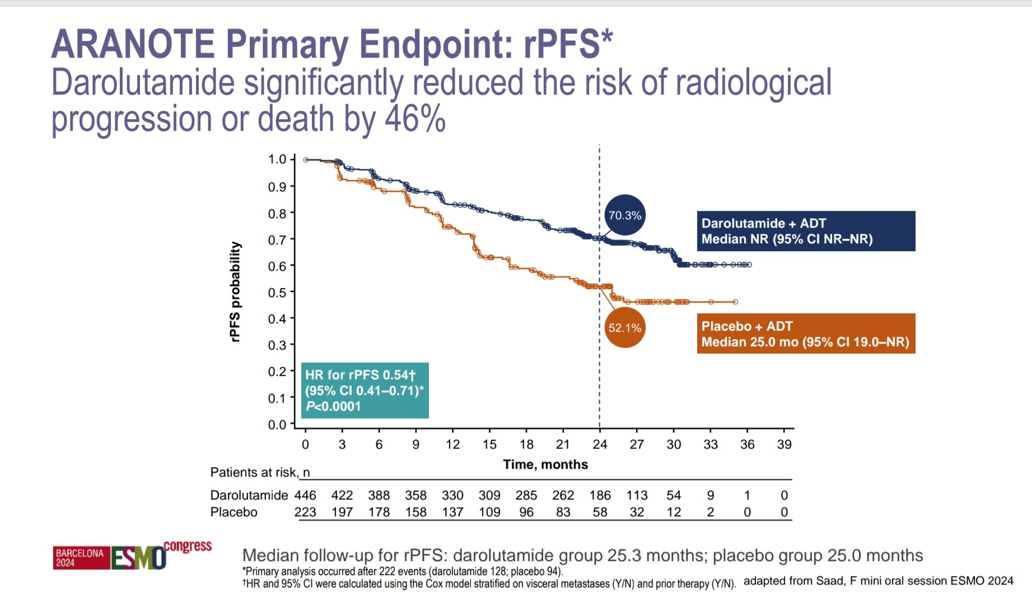

Slide 13
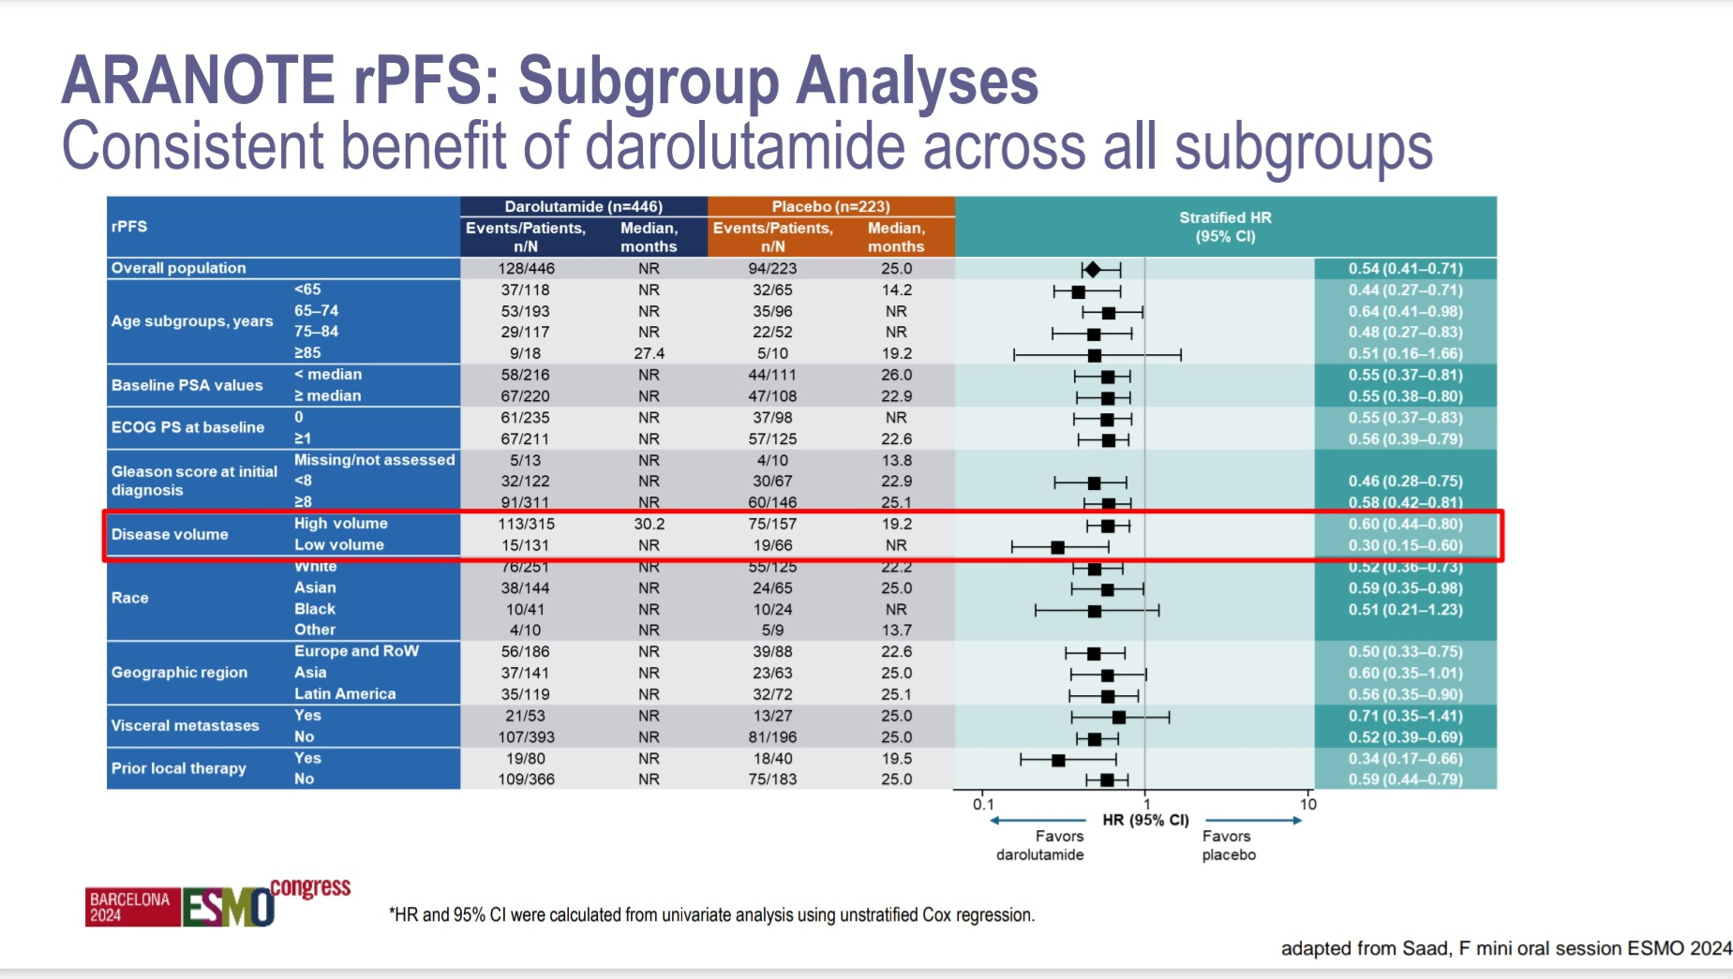

Slide 14
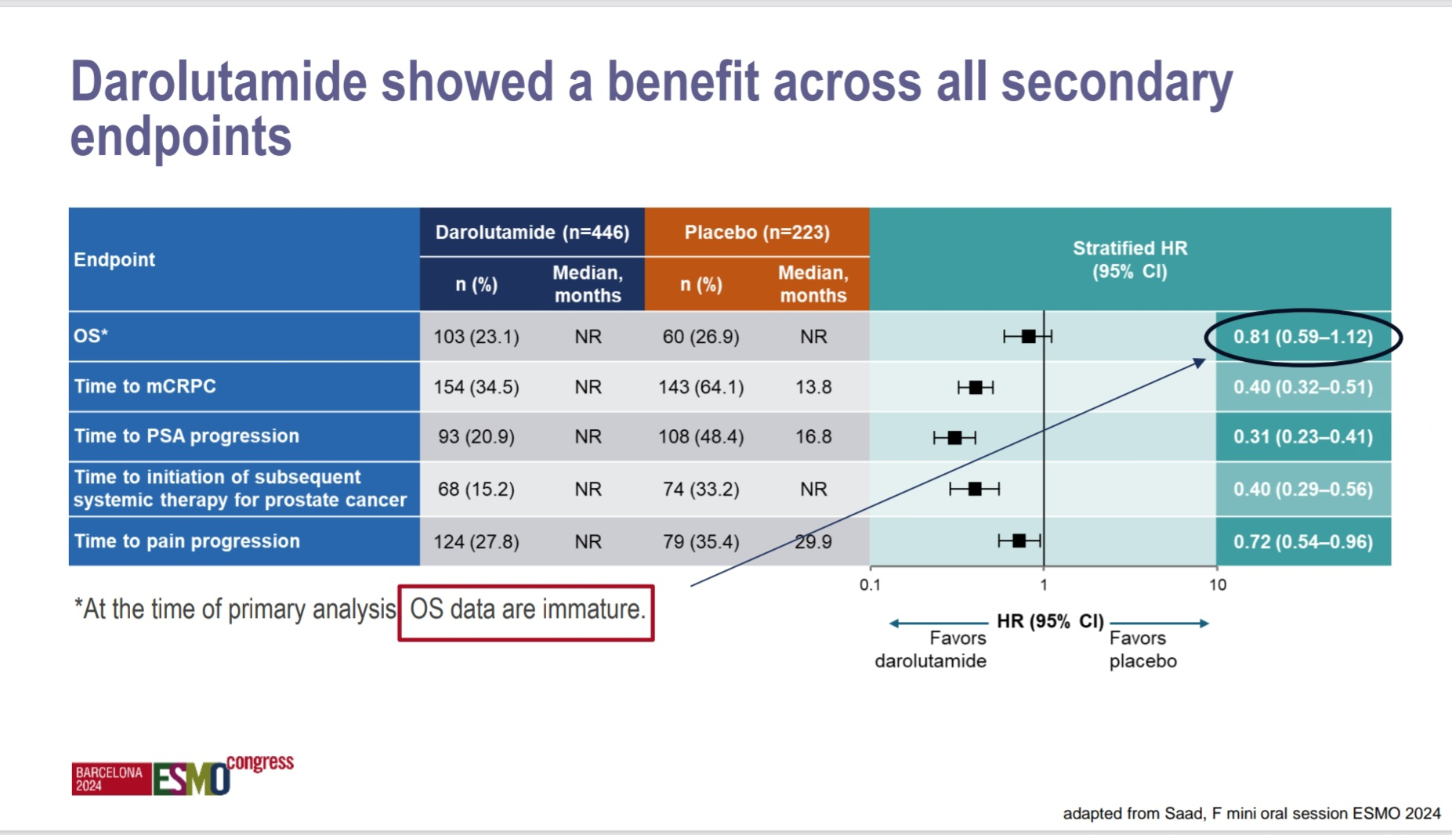

Slide 15
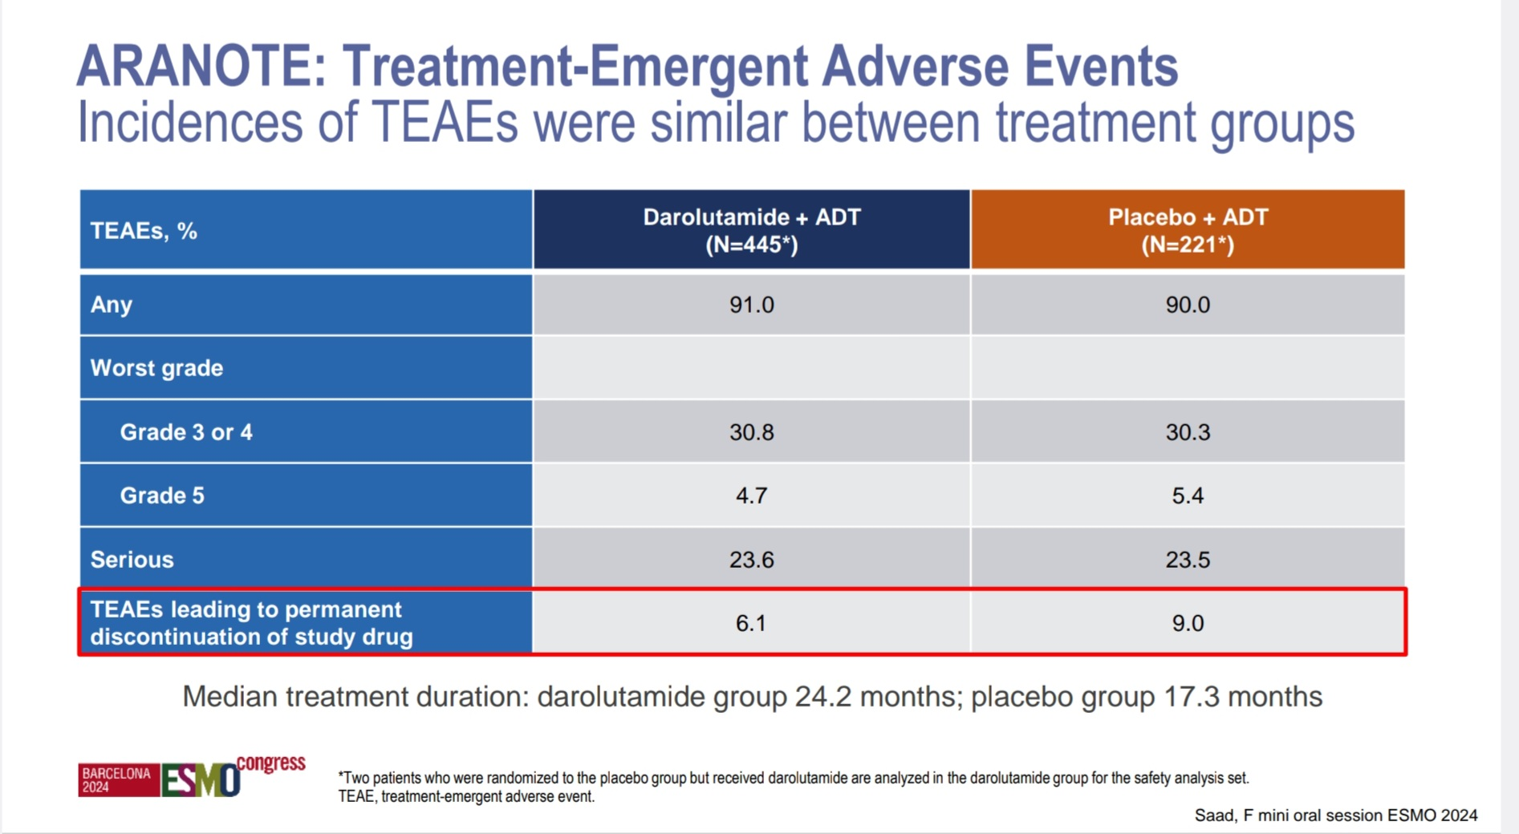

Slide 16
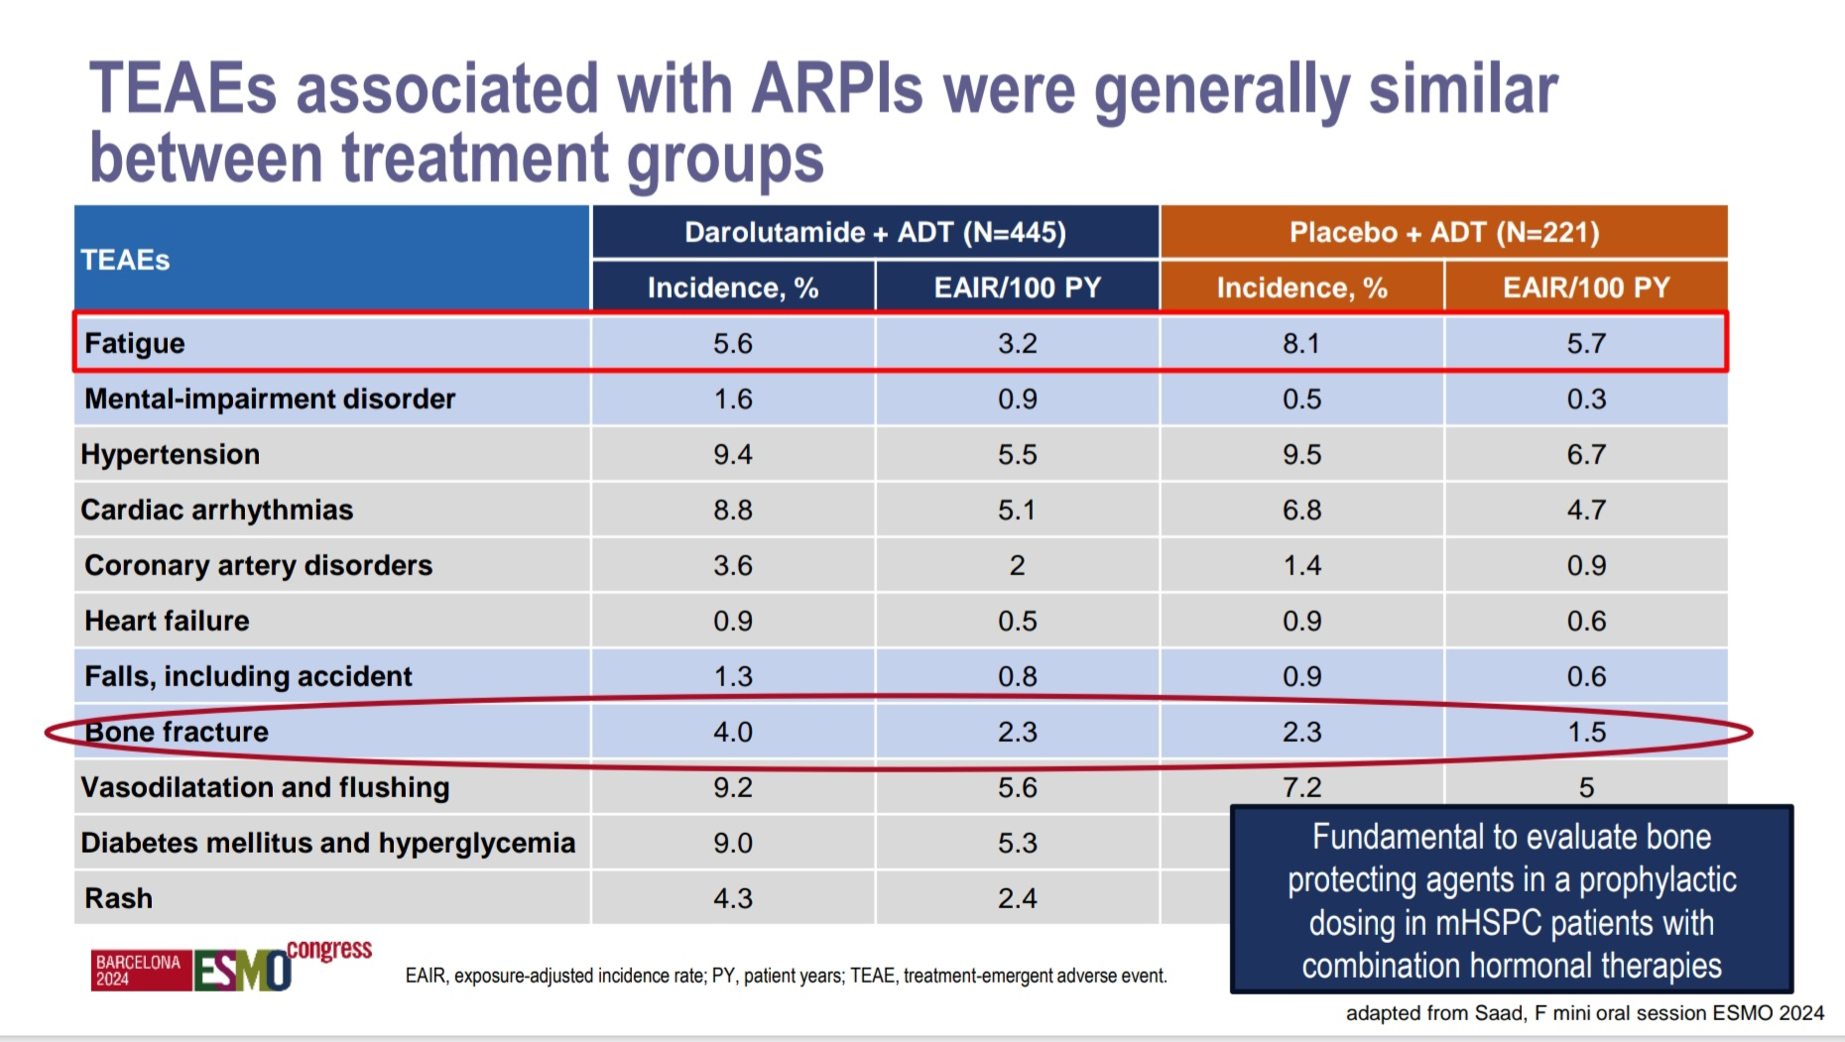

Slide 17
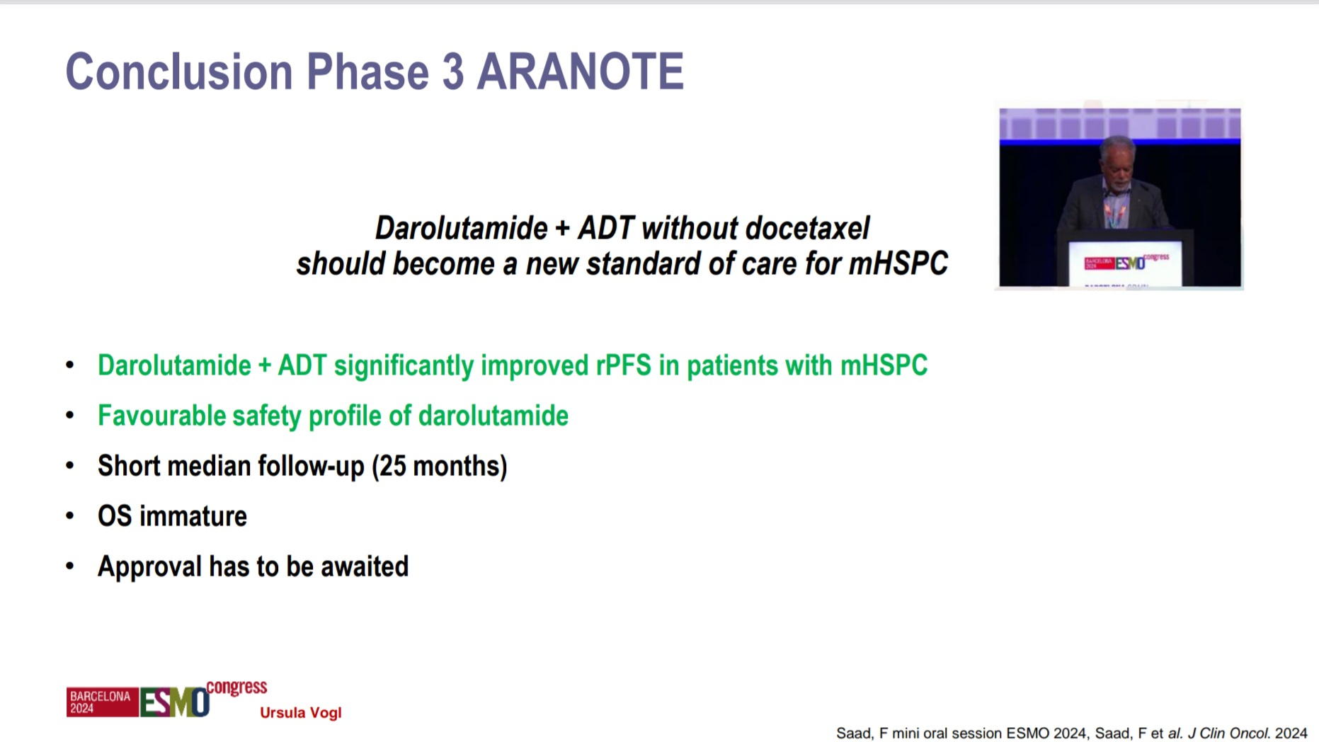

Slide 18
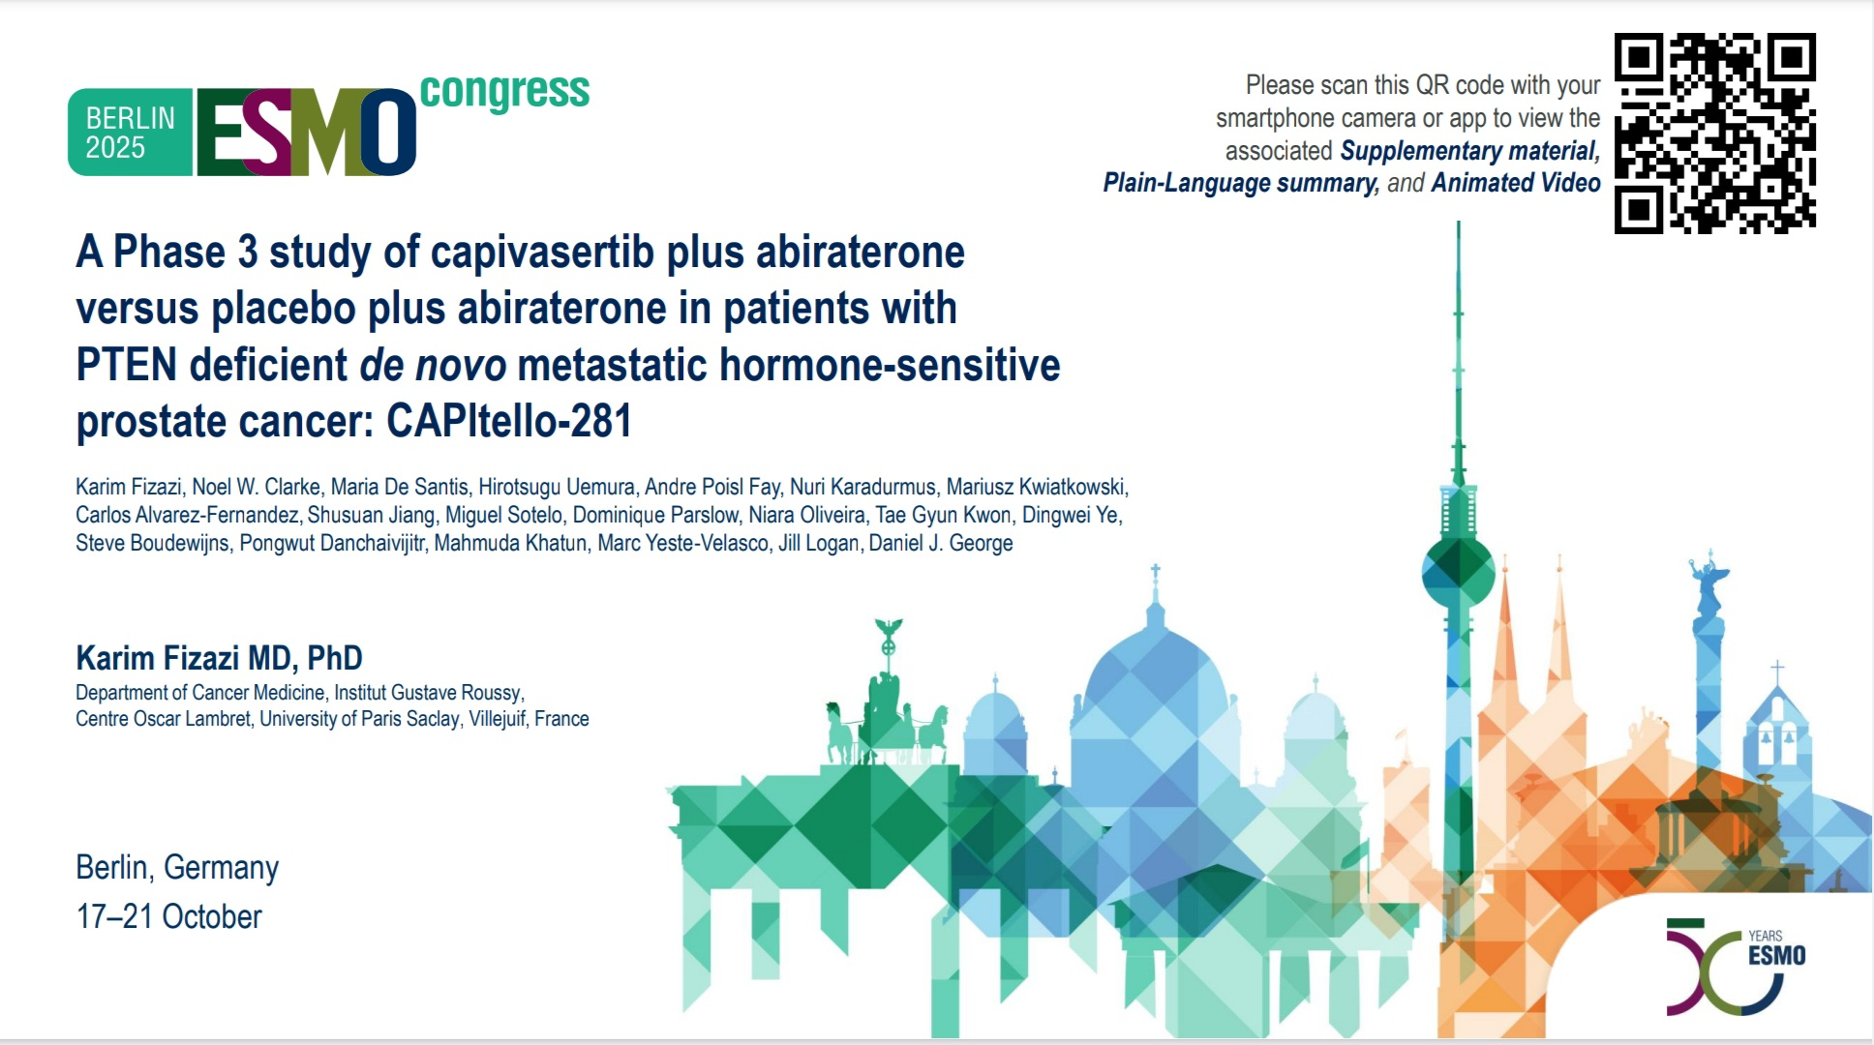

Slide 19
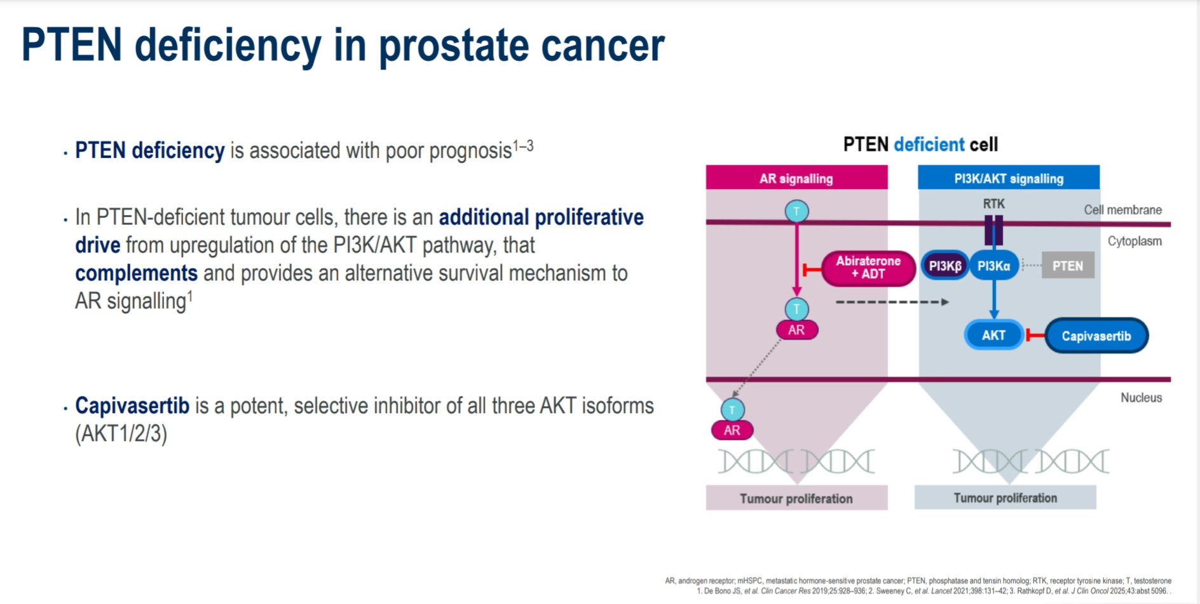

Slide 20
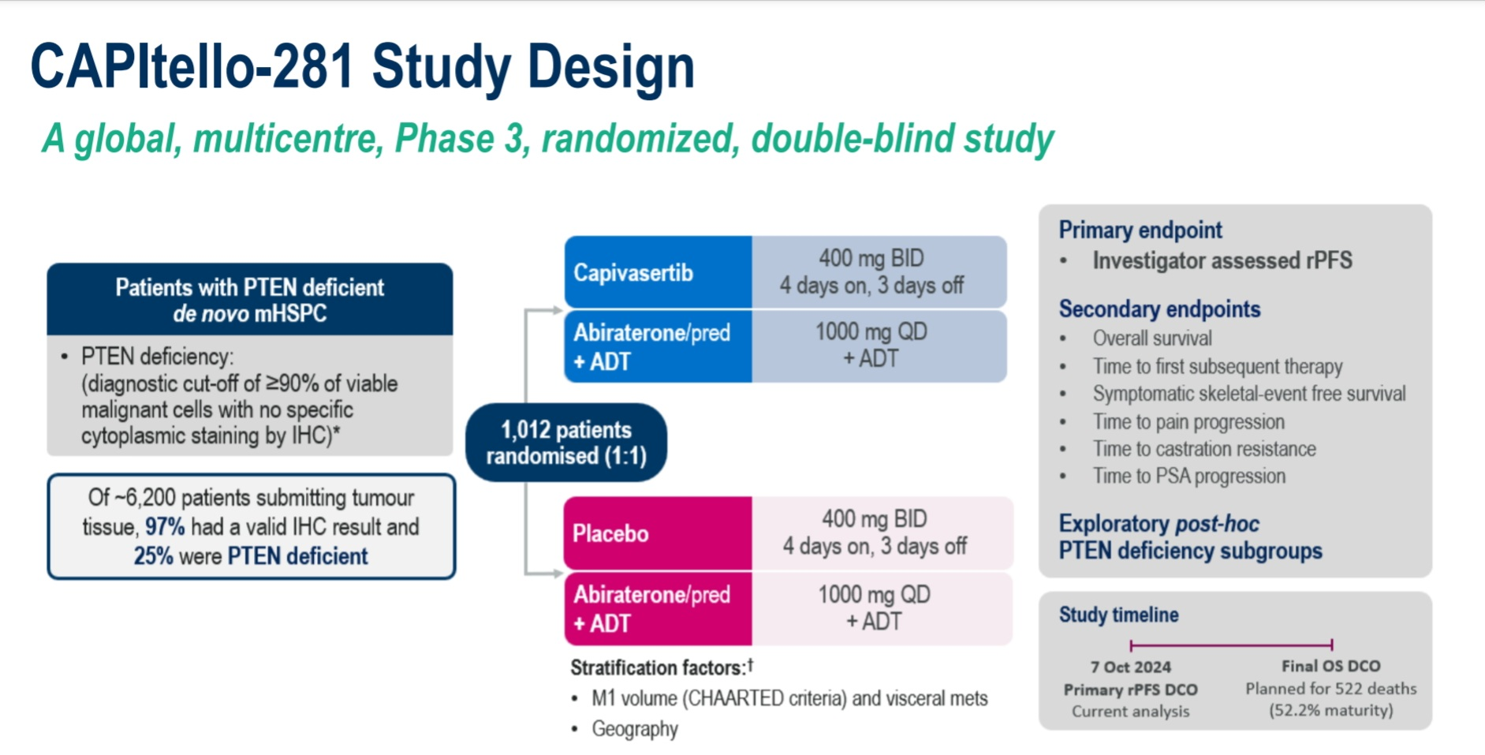

Slide 21
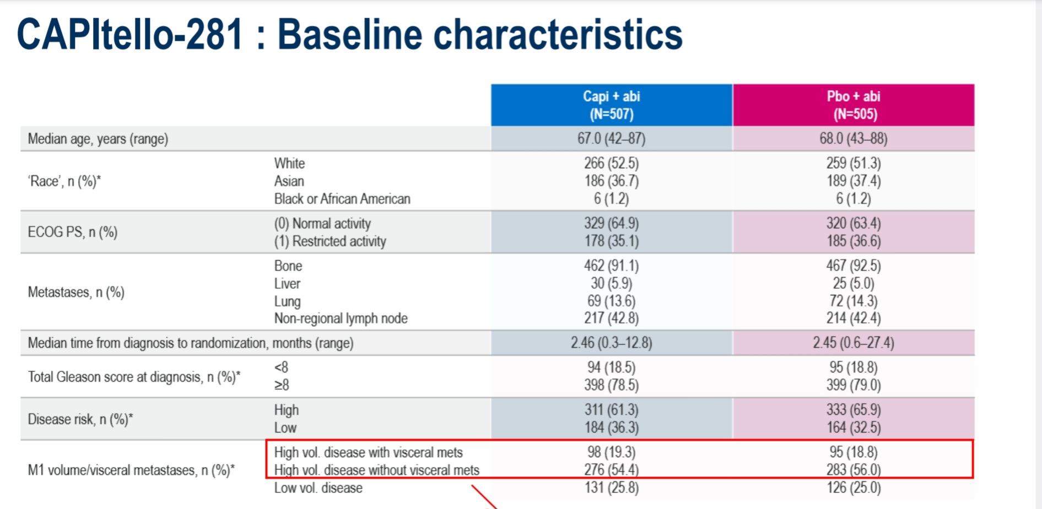

Slide 22
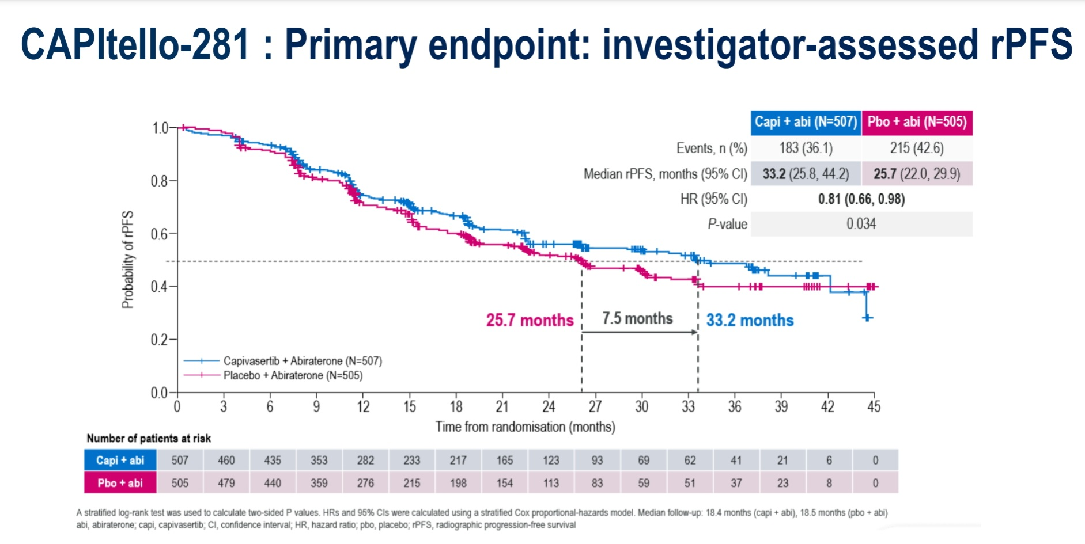

Slide 23
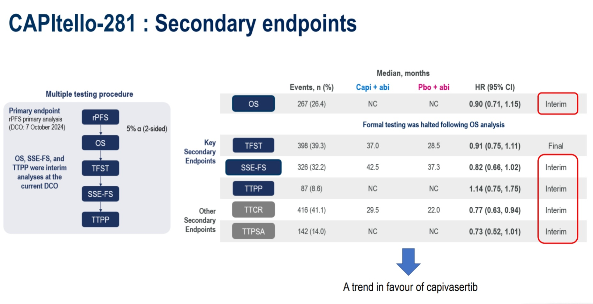

Slide 24
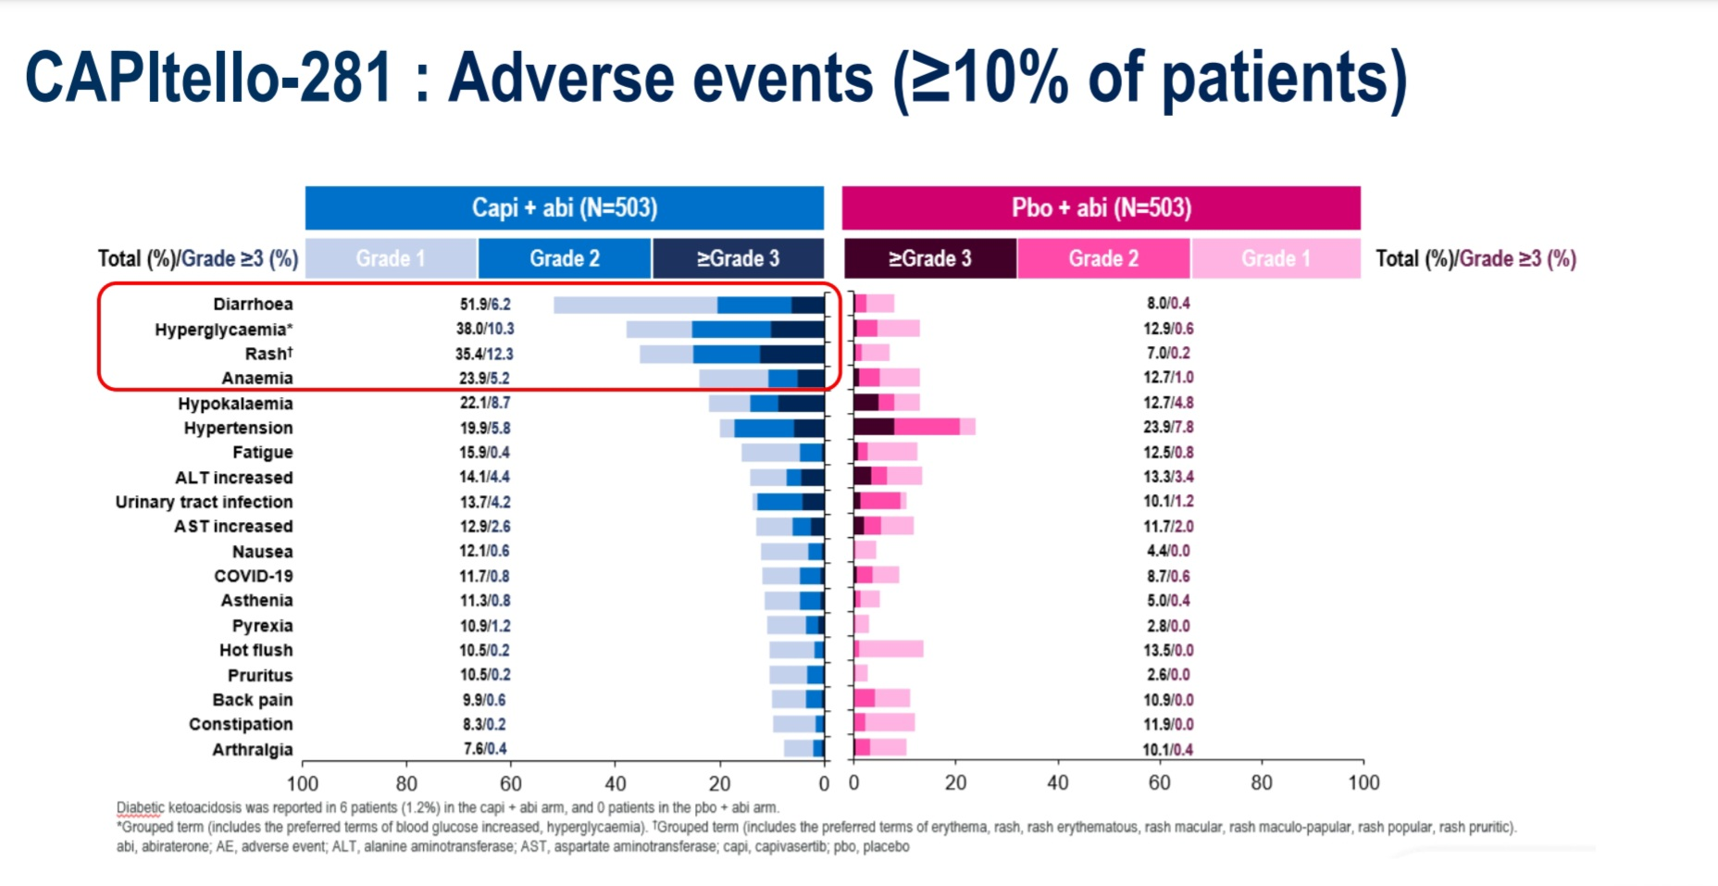

Slide 25
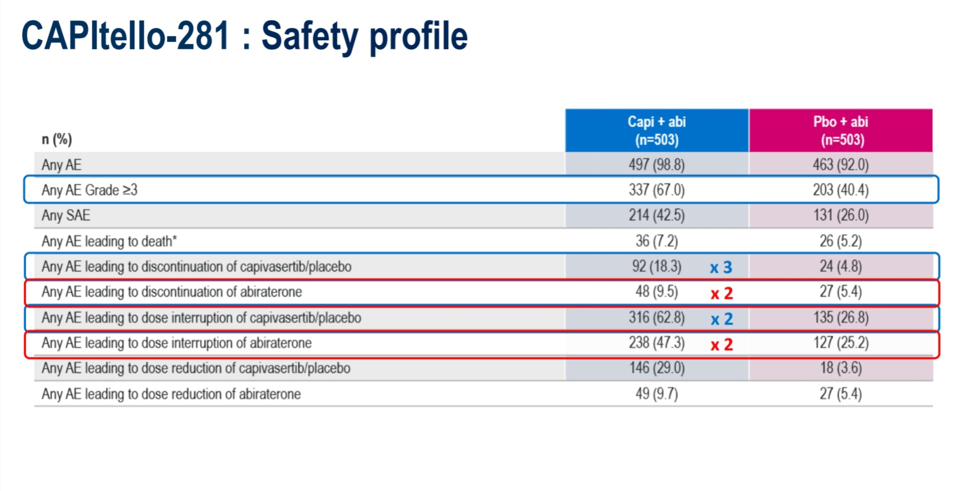

Slide 26
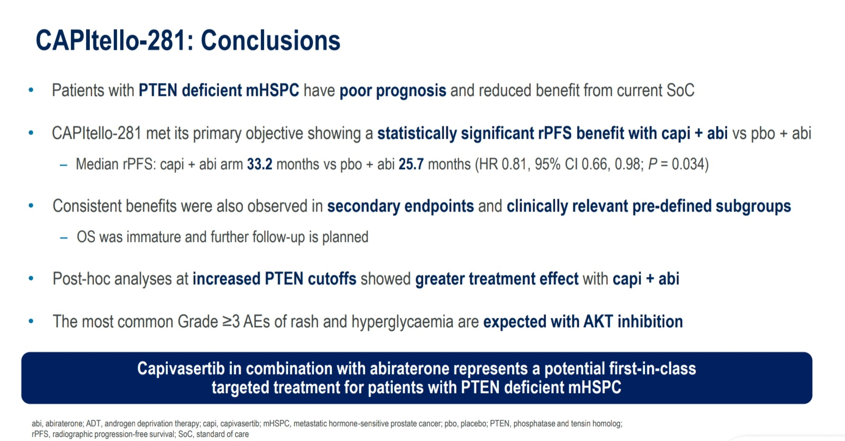

Slide 27
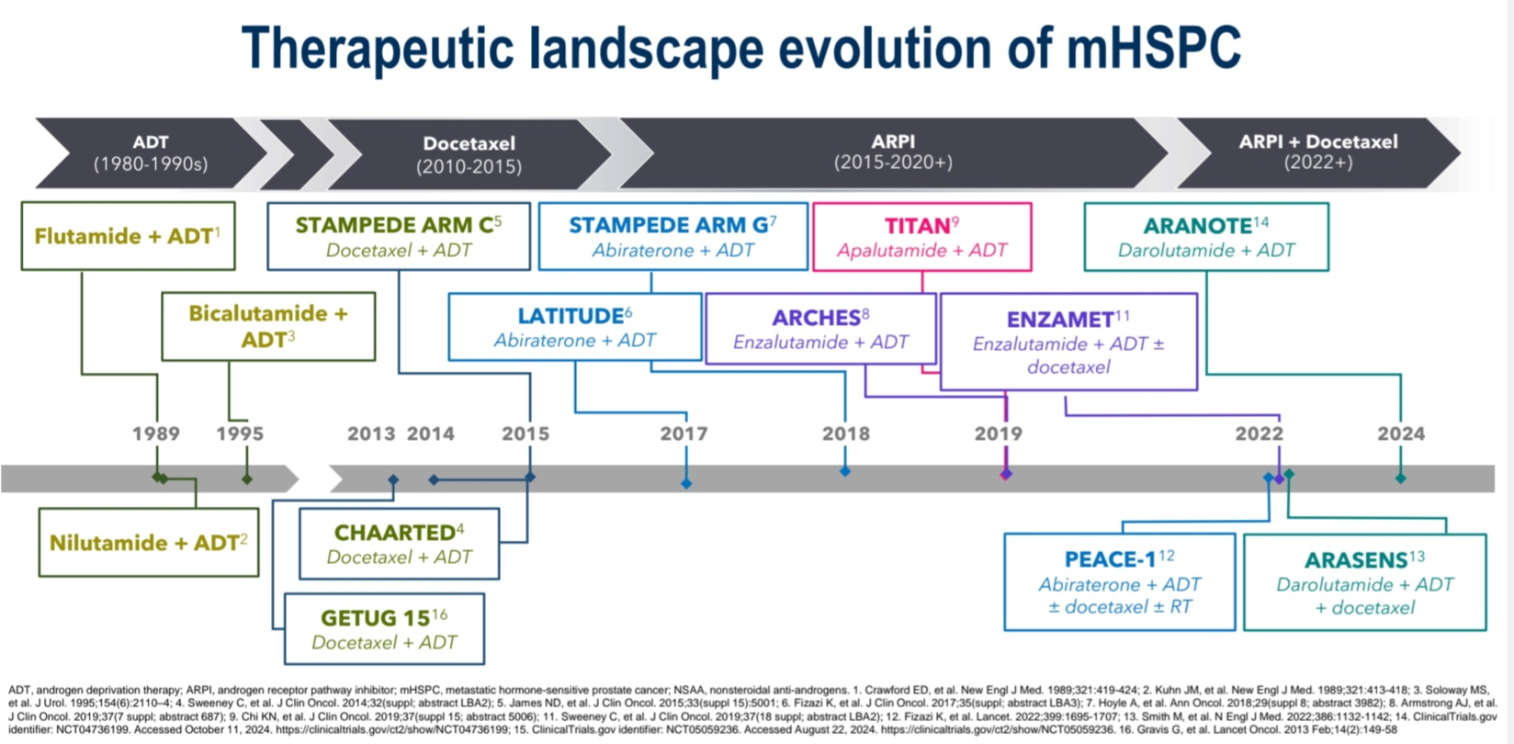

Slide 28
Thank you for your attention

